Slide 1


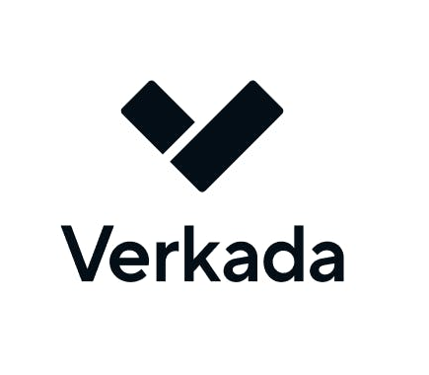
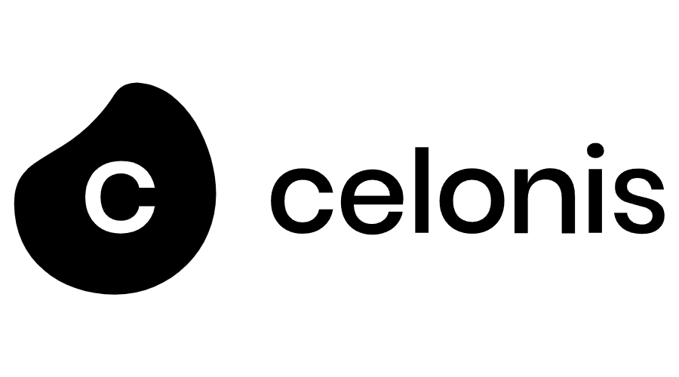
Select Company Overviews
Company | Employees | Total Funding Raised | Valuation | Key Investors | Description
(New York, NY) | 1,000 (Jul 2023) | $801 million (Apr 10, 2023) | $10.3 billion (Mar 1, 2023) | Sequoia Capital, Index Ventures | Develops a cloud security platform for businesses to secure their infrastructure at scale, offering visibility across clouds, containers, and workloads without agents or sidecars.
(Bangalore, India) | 183 (Jan 2023) | $172 million (Jun 12, 2023) | $855 million (Jul 1, 2023) | Ribbit Capital, Omidyar Network | Offers a credit management platform to help users overcome credit card debt and save money on interest, providing automated credit card management and debt management services.
(San Mateo, CA) | 2,065 (Nov 2023) | $455 million (Sep 1, 2023) | $3.3 billion (Nov 1, 2023) | Sequoia Capital, Meritech Capital Partners | Operates a cloud-based physical security platform offering video security cameras, access control, environmental sensors, alarms, and integrated software for real-time physical environment insights.
(Munich, Germany) | 2,886 (Sept 2023) | $1.7 billion (May 1, 2023) | $13 billion (Aug 2022) | Accel, 83North | Develops an execution management system to analyze and optimize business processes for increased productivity, serving industries like production, human resources, and logistics.
Source: Company Filings, Online Sources

